Slide 1
Mental Health Awareness Event in Cyprus’ Sport
By GDA SPORTS Ltd
&
Cyprus Sports Organization

Slide 2
Organizers
Co-organizers

Slide 3
About us
GDA Sports Ltd was founded by Nectarios Alexandrou on May 2021.
Main Focus -> Organize events, such as camps, tournaments, seminars and conferences around the field of “Sports and mental Education”
Contact us at:
info@gdasports.com
admin@gdasports.com
+357 96 797111

Slide 4
Content:
Goal of the Event
Agenda of the Event
Sponsorship Packages
Mental Health Awareness Event in Cyprus’ Sport

Slide 5
The Goal of the Event
Η αναγκαιότητα του συνεδρίου. Videos.
https://youtu.be/VeTxu3ZMPJg
https://youtu.be/WtzYdBGQFw0
https://youtu.be/-cLxgXgHutY

Slide 6
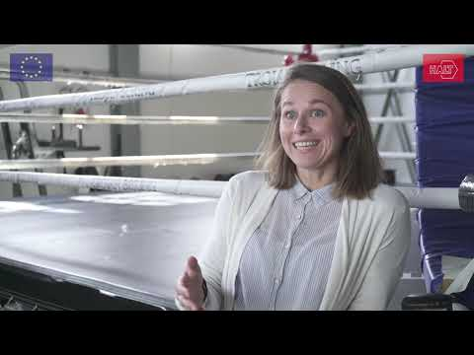

Slide 7
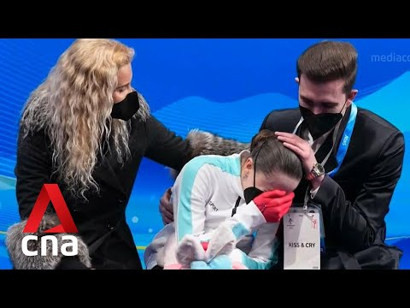

Slide 8
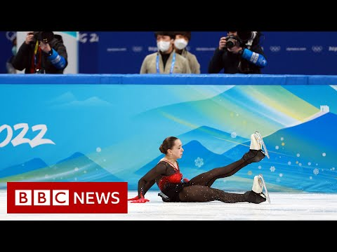

Slide 9
Raise Awareness
for Mental Health in Sports
Create an Action Plan

Slide 10
Details of the Event
9+10 April 2022
1st Day: Open to audience and Mainly Coaches of ΕΣΥΑΑ program (around 350 people) 15:00-19:30
2nd day: Key persons of Cyprus Sports Community (max 30 persons)
9:00-13:30
Raise
Awareness
Discuss
Develop an
Action Plan

Slide 11
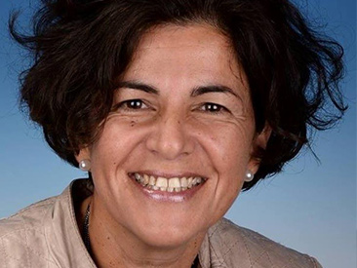
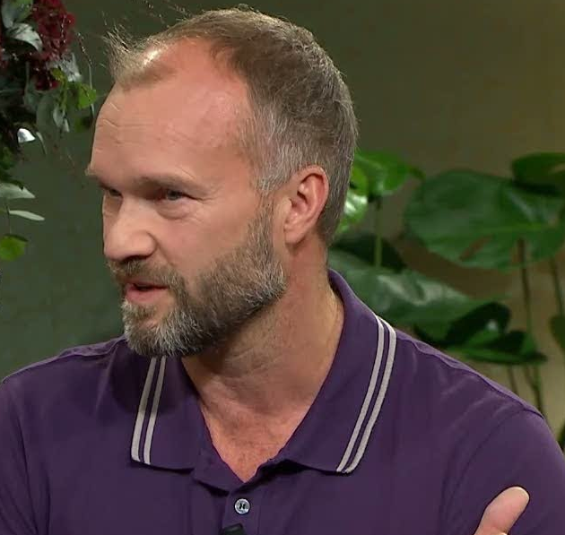
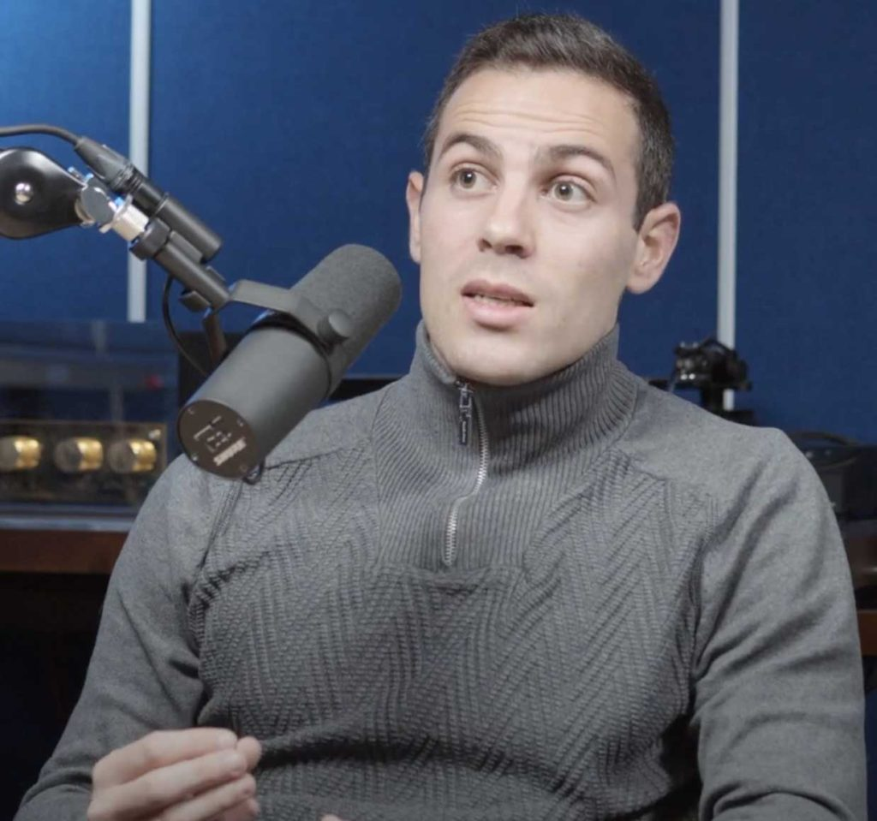
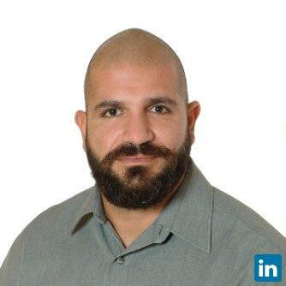
Main
Speakers
Ani Chroni, Ph.D
Göran Kenttä, Ph.D
Adamos Papantoniou
Antonis Alexopoulos, Ph.D

Slide 12
Agenda

Slide 13
By
Chroni & Kenttä
Day 1 – April 9, 2022
Participation requirement
comfortable clothes and sport shoes
eager to learn
Participants will gain understanding and knowledge on
mental health and why it concerns all involved with sports in Cyprus
red flags and consequences of MH
risk factors for MH
practicing compassion and self-care for wellbeing
building resilience for wellbeing
Seminar Approach
selected knowledge on MH shared by seminar speakers
group reflections, with groups formed on the spot

Slide 14
By
Chroni & Kenttä
Day 2 – April 10, 2022
Participation requirement
Have attended Seminar Day 1 in full
Participants will
gain insight and experience in developing MH action plan
have a specific plan ready to implement with their sport
develop a network of people interested in MH matters in sport
develop a support network of people who will also implement a MH action plan
Workshop Approach
group work in the form of discussions and reflections will be an integral part of the day.
groups will be formed with the greatest possible mix to avoid group thinking and challenge participants to think outside of the box
walk and talk lunch to enhance mingling and comfort and trigger out of the box thinking

Slide 15
Marketing
Strategy
Prior to the event, during and after
Electronic media (TV, radio, Online)
Social Media of CSO, GDA Sports Ltd, Nectarios Alexandrou
Website of the Event

Slide 16
Prior to the
Event
TV Media Sponsors:
Cablenet Sports TV
Alpha TV
Online Media Sponsor:
Digital Tree (kerkida.net)
Visits in all Radios & 1 TV show in each channel
With the Support of ΕΑΚ (Cyprus Sports Writers Organization)
Social Media of CSO, GDA Sports Ltd, Nectarios Alexandrou
Website of the Event

Slide 17
During the
Event
FULLY Digital On Stage Setup with 15m LED displays
Banners in Stadium
Sponsors branded giveaways
Storytelling Powered by (a Sponsor)
Parts of the Event to be named on Gold Sponsors brand
Branding on flags outside of the Stadium
Branding on Photo Banner
Branding on the Entrance
Special Mention in Nectarios Welcoming & Conclusion Speech for Gold & Platinum Sponsors
Live Streaming PopUp Banners/Windows
Live Streaming Official Sponsor Powered By -

Slide 18
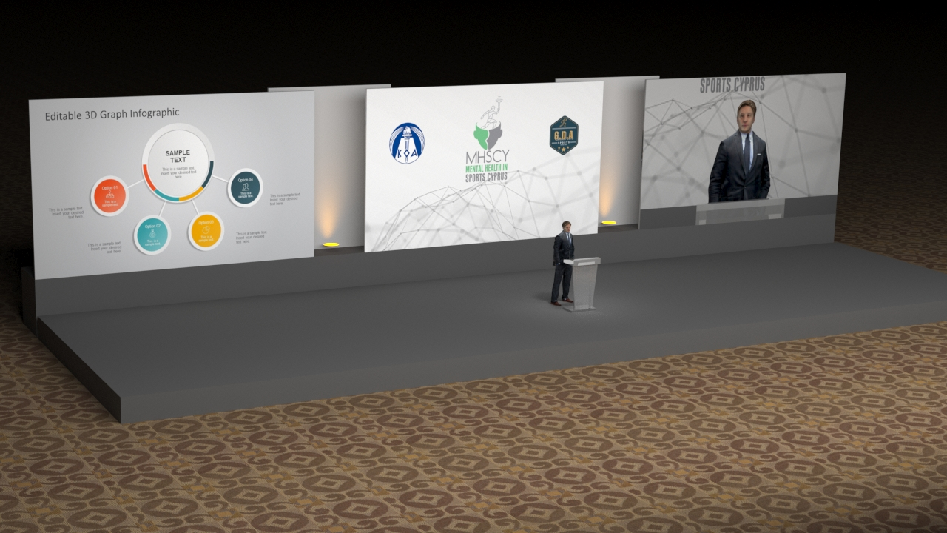

Slide 19
After the
Event
Post Event Videos in TV Channels news (TV Coverage?)
Post Event Video on Social Media of CSO, GDA Sports LTD, Nectarios Alexandrou
Event to be sold separately online (1st Day) with branding online on sales advertisements and during playback
Nec Podcast Powered by (a Sponsor)

Slide 20
Sponsorship
Packages

Slide 21
Sponsorship Packages
Platinum Sponsor € 10 000
Gold Sponsor € 5000
Silver Sponsor € 1500

Slide 22
Platinum
Package
EVENT NAME. The Event will take the name of the Brand. (E.g The [brand] presents the 1st MHSCY conference, or [brand] MHSCY conference)
Mentions in all presentations, visits, branding, flyers
30% Discount on Sponsorships of the next Event of GDA Sports under the same Program of Mental health in Sports Cyprus.
Presence on all dinners and lunches
Nectarios Alexandrou free “powered by” collaboration on his PODCAST for 3 months. Social media and on live
5’ Interview of the Speakers for brand’s use on Social Media/website etc
Participant on all dinners and lunches with speakers and vip
ABOVE ALL NON PRICED VALUE ON THE CONTRIBUTION OF SUCH NEEDED EVENT TO SHAPE THE FUTURE OF OUR KIDS SPORTS

Slide 23
Gold
Package
1 part (1,5 hours) of each day under the name of the brand.
Mentions in all TVs during the named part
Branding HIGH in all printed material
Branding in all pre & post event marketing
Gift to participants
Photos with Speakers in front of the brand’s & event’s banners to promote on brand’s social and other media
Storytelling powered by
Mentions on Nectarios Alexandrou‘s Upcoming Podcast with a part of it branded
20% Discount on Sponsorships of the next Event of GDA Sports under the same Program of Mental health in Sports Cyprus.
ABOVE ALL NON PRICED VALUE ON THE CONTRIBUTION OF SUCH NEEDED EVENT TO SHAPE THE FUTURE OF OUR KIDS SPORTS

Slide 24
Silver
Package
Brand‘s logo on all printed material
Branding on all Banners and LED Creatives during the event
Branding on Live Streaming and post event program
Gifts to participants
Branding on the Catering Area
Photo with the Speakers in front of the event’s and brand’s banner
Interview with Nectarios for use on social media platforms
Free Giveaway products on Nectarios Alexandrou’s upcoming PODCAST
15% Discount on Sponsorships of the next Event of GDA Sports under the same Program of Mental health in Sports Cyprus.
ABOVE ALL NON PRICED VALUE ON THE CONTRIBUTION OF SUCH NEEDED EVENT TO SHAPE THE FUTURE OF OUR KIDS SPORTS

Slide 25
Roadmap
Establish a collaboration with CSO
Organize the Event
Book the location
Book the flights
Book the accommodation
Supervision of the event
1
3
5
2
4
6
Book the Speakers
Promote the event
Follow-up with the key persons
Plan for future seminars

Slide 26
Thank you.
Our Goal:
Build and Execute a 3-year Action Plan on Mental Health in Cyprus Sports

